Slide 1
Section 4.1
Linear Functions and Their Properties
Copyright © 2012 Pearson Education, Inc. Publishing as Prentice Hall.

Slide 2

Copyright © 2012 Pearson Education, Inc. Publishing as Prentice Hall.

Slide 3

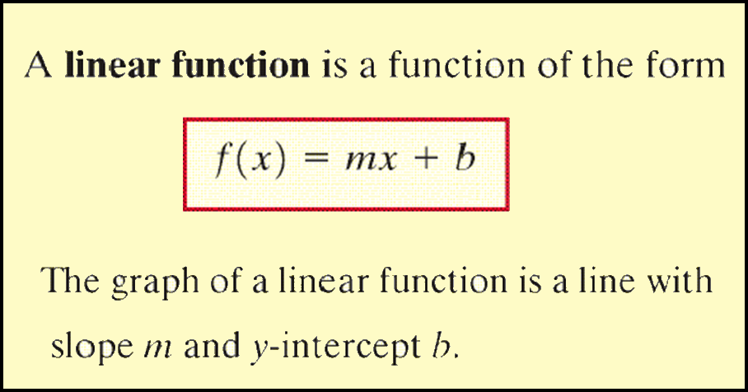
Copyright © 2012 Pearson Education, Inc. Publishing as Prentice Hall.

Slide 4

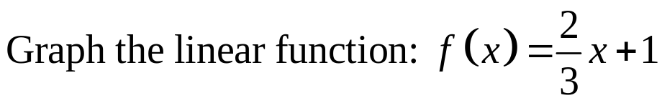
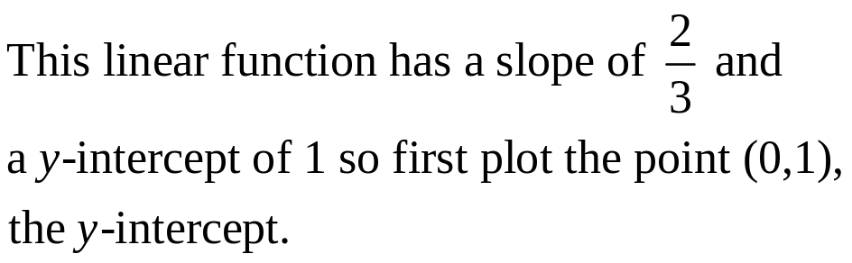
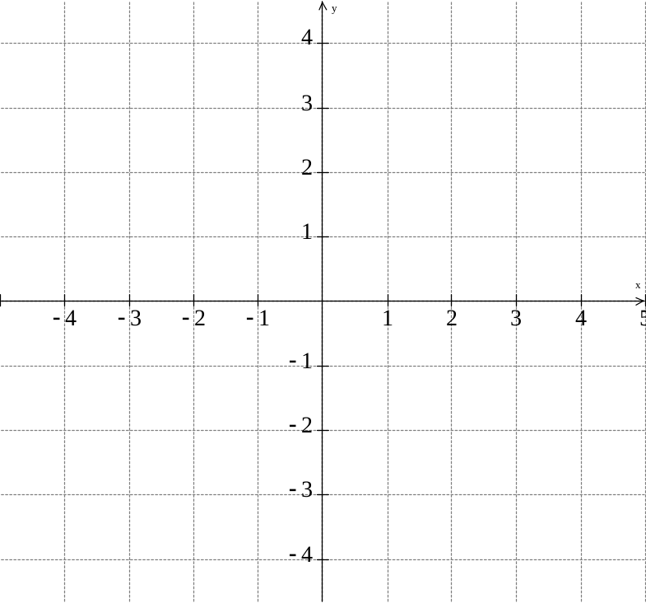


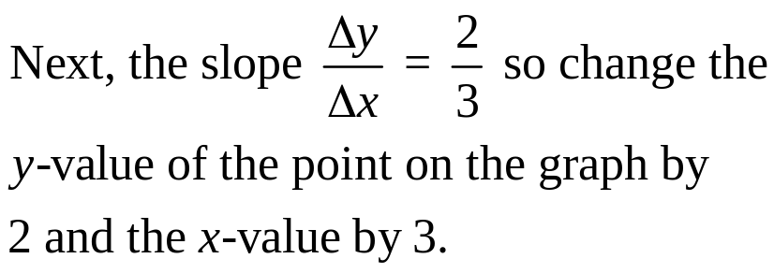
Copyright © 2012 Pearson Education, Inc. Publishing as Prentice Hall.

Slide 5
Copyright © 2012 Pearson Education, Inc. Publishing as Prentice Hall.

Slide 6
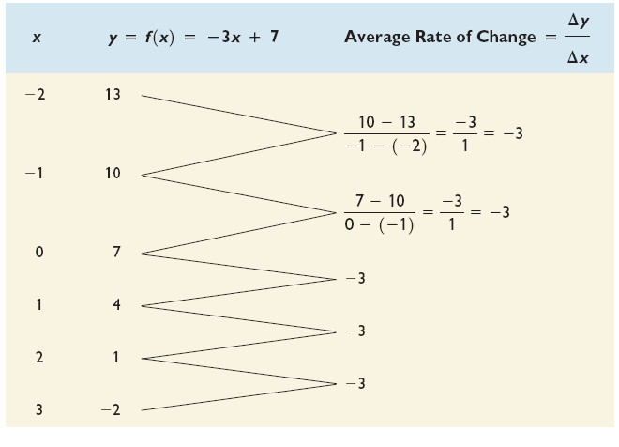
Copyright © 2012 Pearson Education, Inc. Publishing as Prentice Hall.

Slide 7

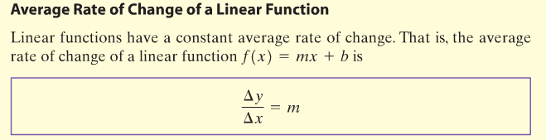
Copyright © 2012 Pearson Education, Inc. Publishing as Prentice Hall.

Slide 8
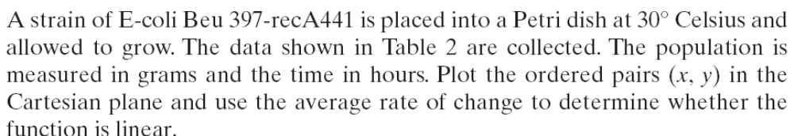
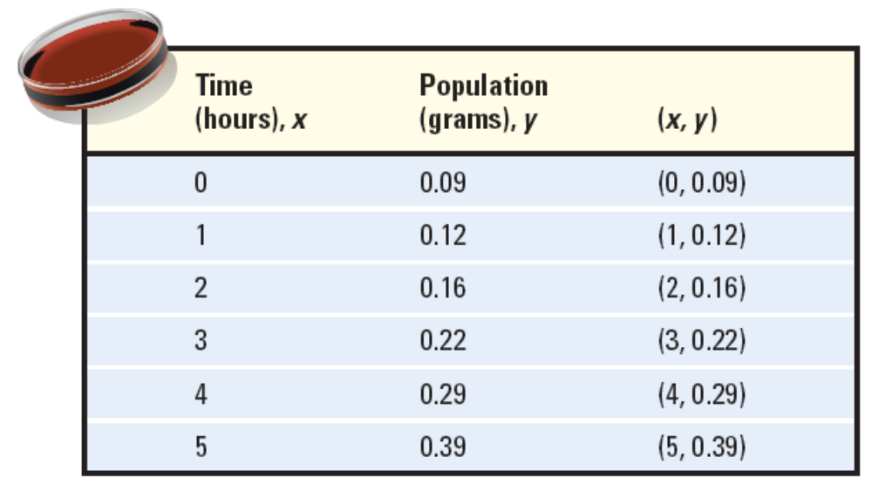
Copyright © 2012 Pearson Education, Inc. Publishing as Prentice Hall.

Slide 9
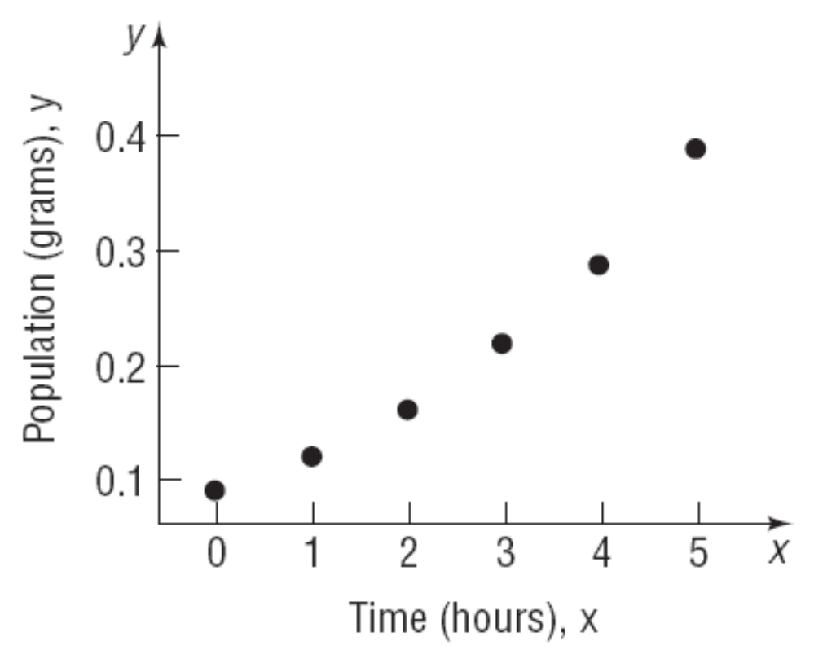
Copyright © 2012 Pearson Education, Inc. Publishing as Prentice Hall.

Slide 10
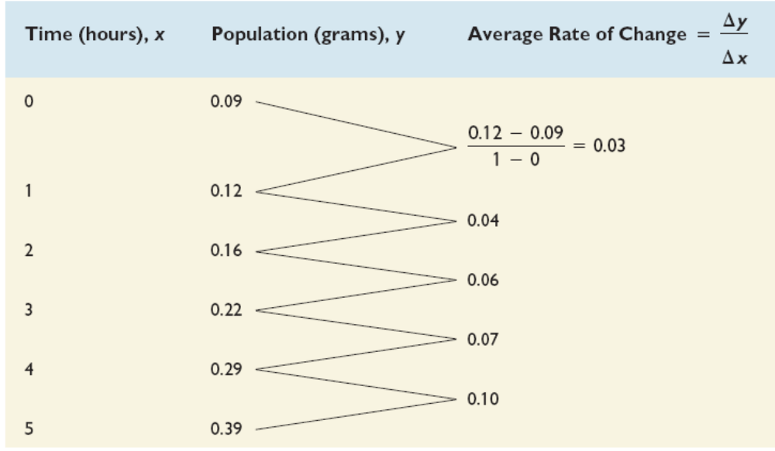
Since the average rate of change is not constant, the function is not linear.
Copyright © 2012 Pearson Education, Inc. Publishing as Prentice Hall.

Slide 11
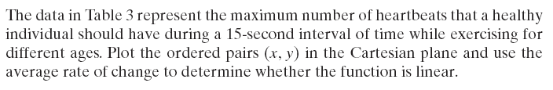
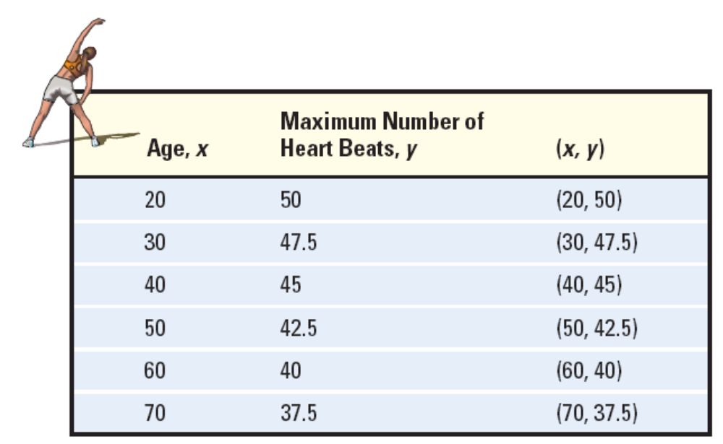
Copyright © 2012 Pearson Education, Inc. Publishing as Prentice Hall.

Slide 12
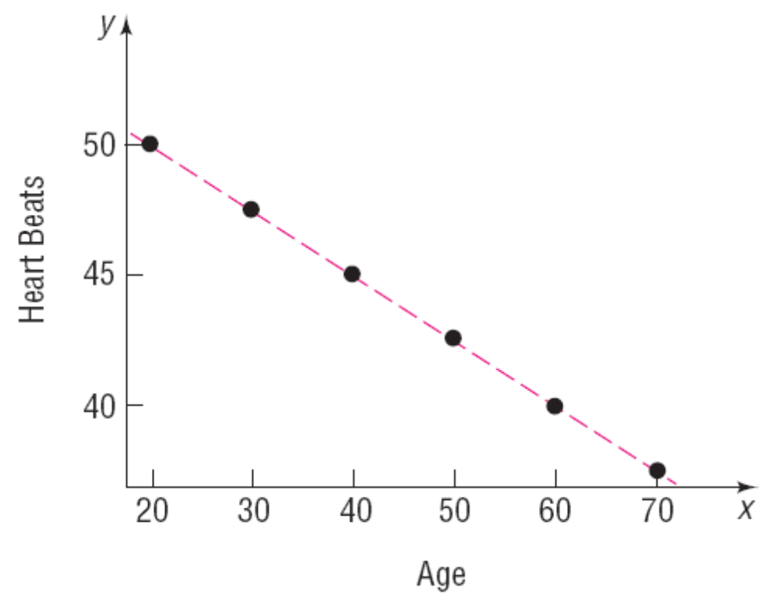
Copyright © 2012 Pearson Education, Inc. Publishing as Prentice Hall.

Slide 13
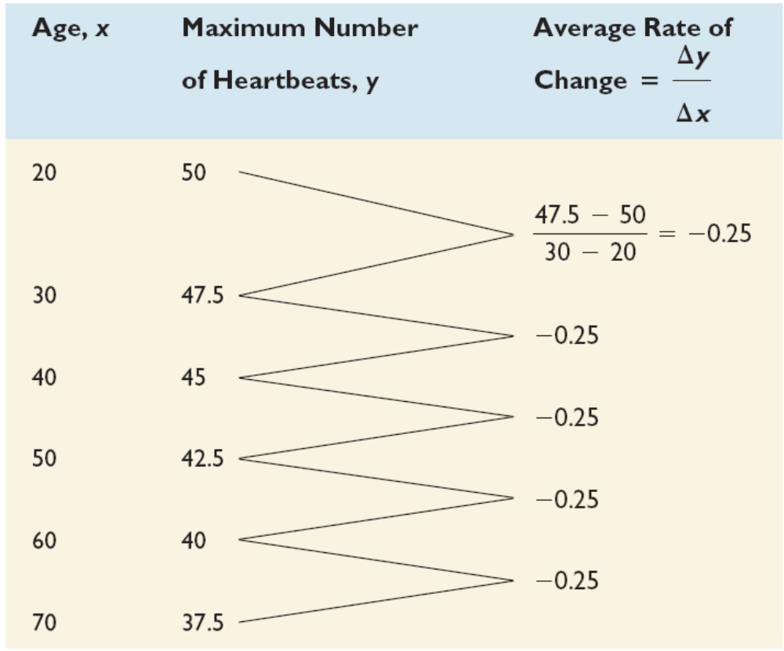
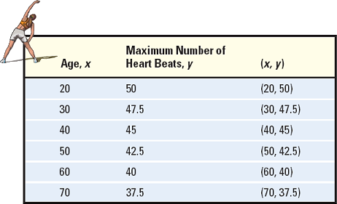
Since the average rate of change is a constant –0.25, the function is linear.
Copyright © 2012 Pearson Education, Inc. Publishing as Prentice Hall.

Slide 14

CONSTANT
INCREASING
DECREASING
Copyright © 2012 Pearson Education, Inc. Publishing as Prentice Hall.

Slide 15

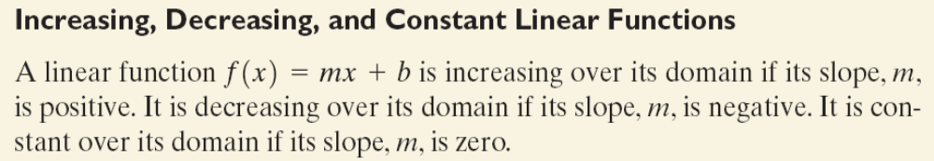
Copyright © 2012 Pearson Education, Inc. Publishing as Prentice Hall.

Slide 16
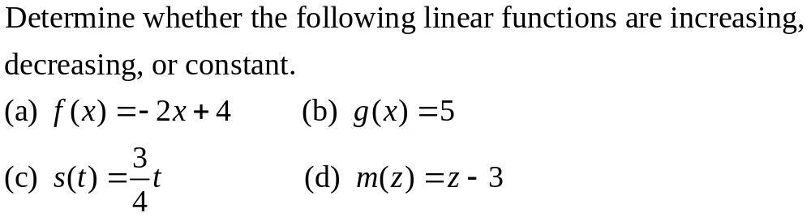
Copyright © 2012 Pearson Education, Inc. Publishing as Prentice Hall.

Slide 17
Copyright © 2012 Pearson Education, Inc. Publishing as Prentice Hall.

Slide 18
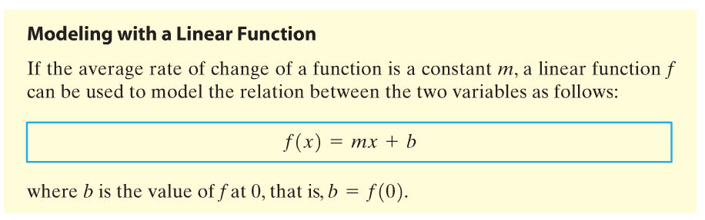
Copyright © 2012 Pearson Education, Inc. Publishing as Prentice Hall.

Slide 19
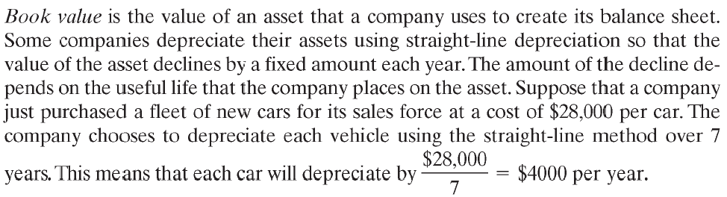
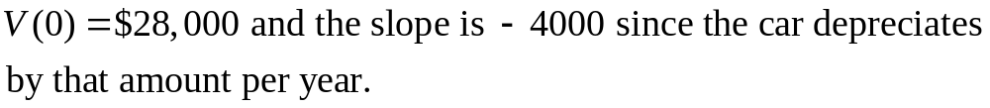

Copyright © 2012 Pearson Education, Inc. Publishing as Prentice Hall.

Slide 20


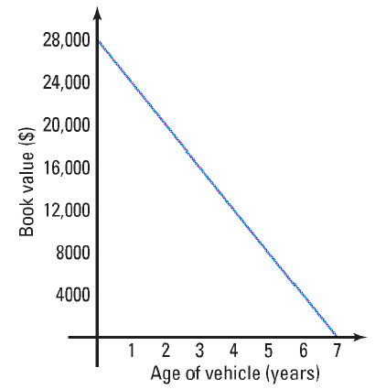
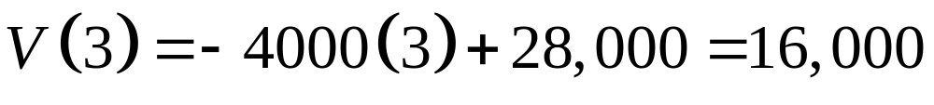
After 3 years the book value is $16,000.
Copyright © 2012 Pearson Education, Inc. Publishing as Prentice Hall.

Slide 21


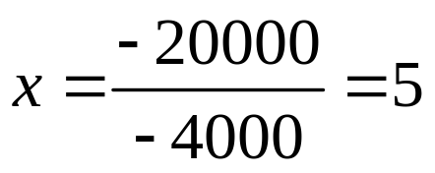

(d) The slope is the average rate of change and is –4000 so this means that for each additional year that passes, the book value of the car decreases by $4000.
The car will have a book value of $8000 when it is 5 years old.
Copyright © 2012 Pearson Education, Inc. Publishing as Prentice Hall.

Slide 22
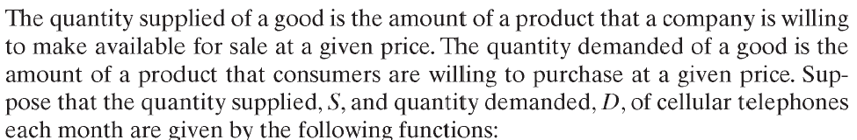
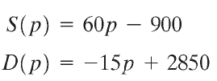
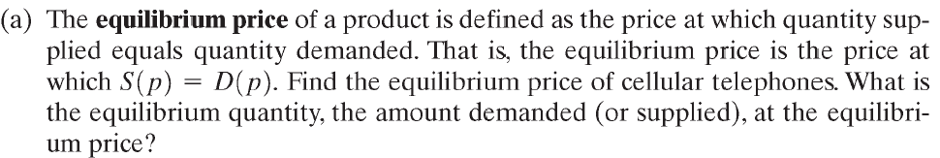
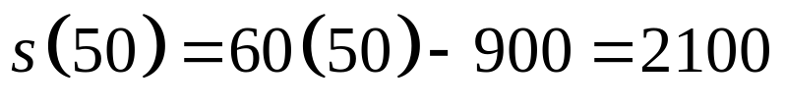



So the equilibrium price is $50 and the equilibrium quantity is 2100 phones.
Copyright © 2012 Pearson Education, Inc. Publishing as Prentice Hall.

Slide 23





Copyright © 2012 Pearson Education, Inc. Publishing as Prentice Hall.

Slide 24
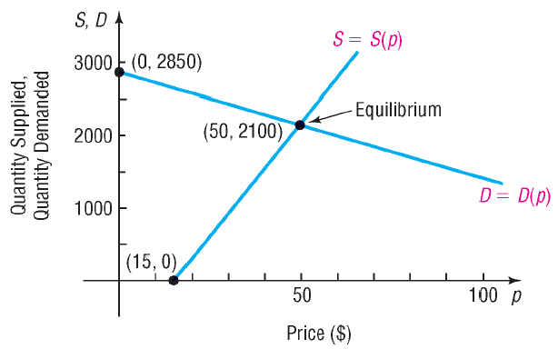
Copyright © 2012 Pearson Education, Inc. Publishing as Prentice Hall.

